Slide 1



Point of Sales System
"The Future of Retail: Embracing Point of Sale Innovation"

Slide 2

Our team
ANIKA CHAKRABORTY
2104010202258
ORNI BANIK
2104010202261
MOUMITA NAG
2104010202264
MIFTAHUL JANNAT
2104010202275
2

Slide 3
1.Introduction 2.Project organization 3.System Requirements 4.System Architecture 5.System Class Diagram 6.Project Demonstration 7.Limitation
CONTENT

Slide 4
Introduction
A Point of Sales (POS) system is an integration consisting hardware and software to handle business transactions like item scanning, monies handling generation as well. It also provides with additional features like inventory updates, sales tracking etc. POS systems: The Retailers and the Chains : Widely used in industry like retail, hospitality to enhance operational efficiency accuracy customer experiences.
4

Slide 5





SYSTEM REQUIREMENTS
WEB FRAMEWORK
DATABSE MANAGEMENT SYSTEM
VERSION CONTROL SYSTEM
DEVELOPMENT ENVIRONMENT
FRONT-END TECHNOLOGIES
LARAVEL
HTML
CSS
XAMPP
VISUAL STUDIO CODE
MySQL
GIT

Slide 6
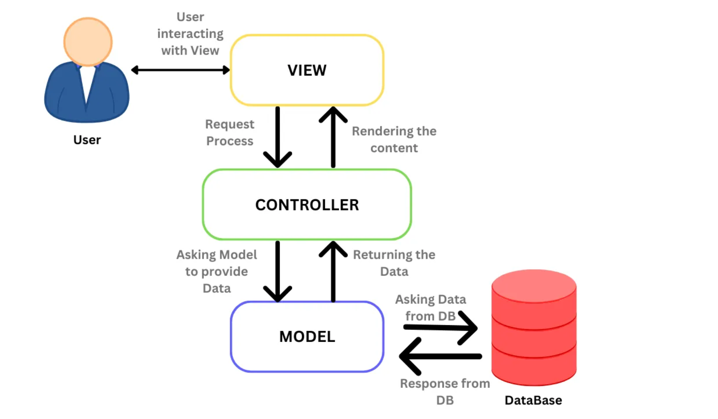
SYSTEM ARCHITECTURE

Slide 7
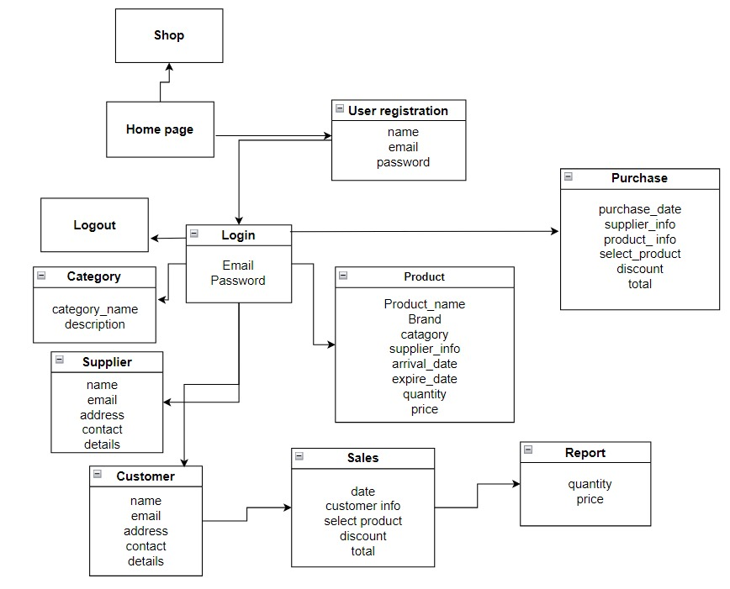
POS System Class Diagram
7

Slide 8
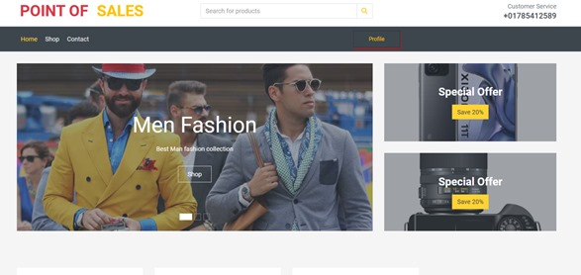
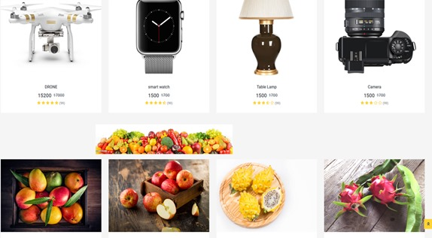
POS System Demo
Home Page
Shop

Slide 9
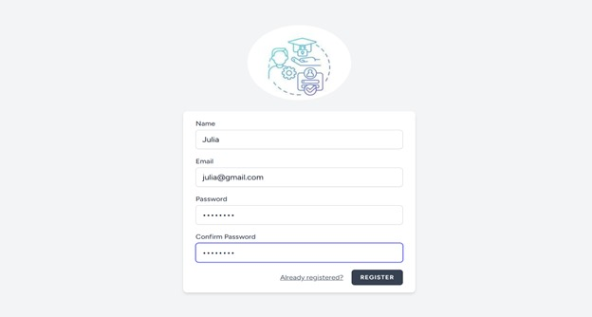
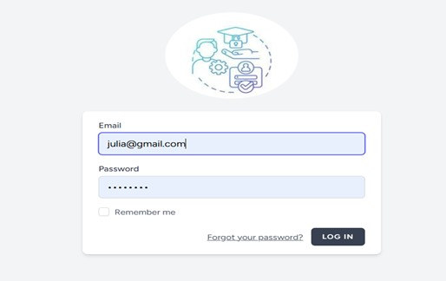
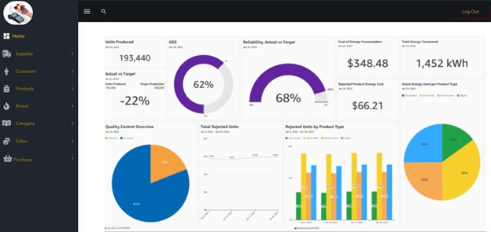
User Registration
User Login
User Dashboard

Slide 10
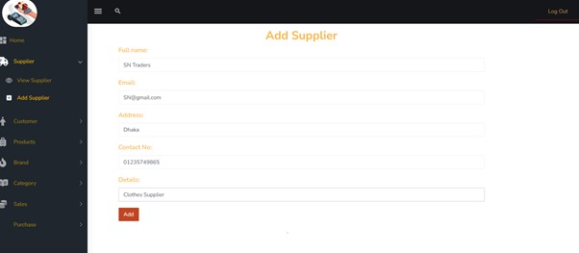
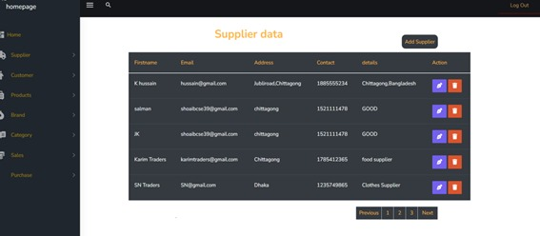
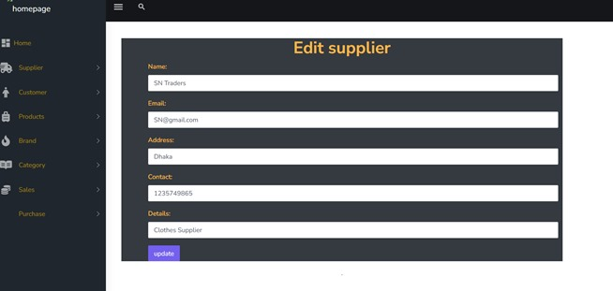
Supplier
Add
View
Edit (Add/Delete)

Slide 11
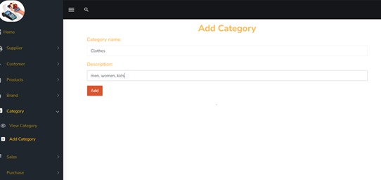
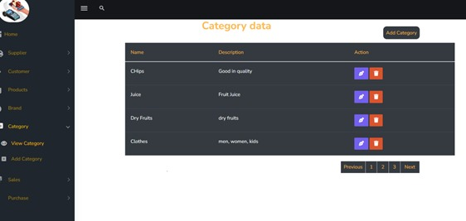
Category
Add
View

Slide 12
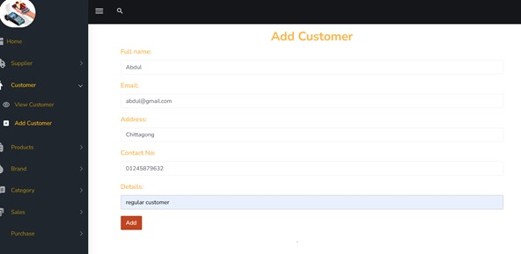
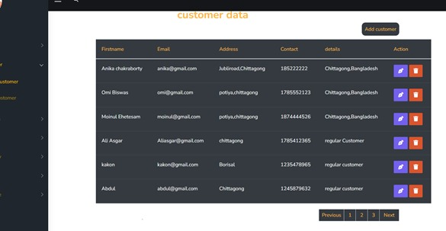
Customer
Add
View

Slide 13
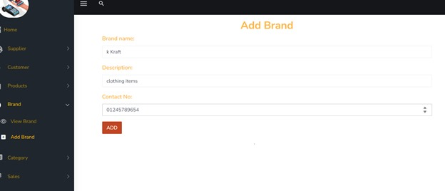
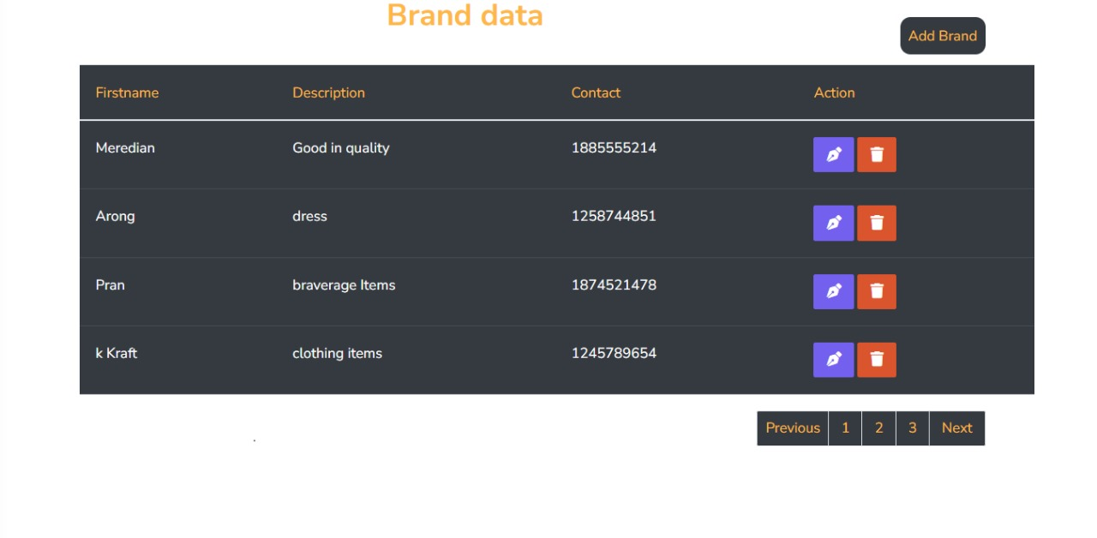
Add Brand
View Brand Data

Slide 14
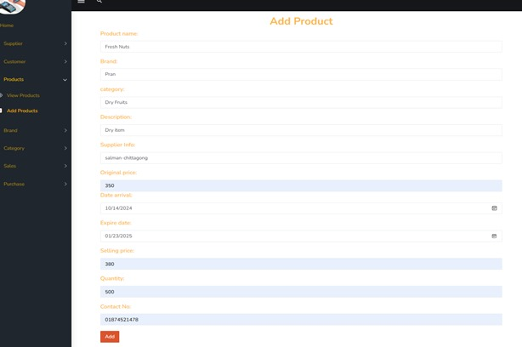
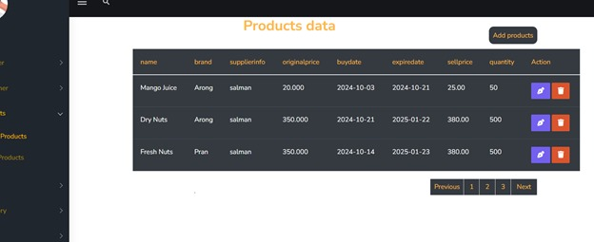
Add Product
View Product Data

Slide 15
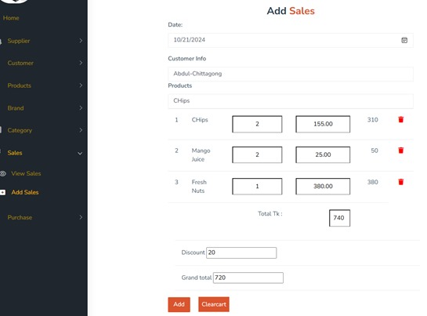
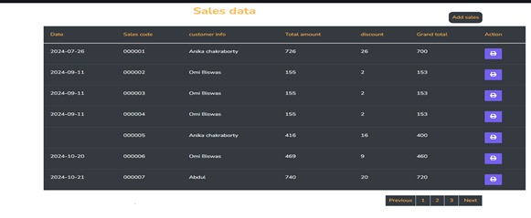
Add Sales
View Sales Data

Slide 16
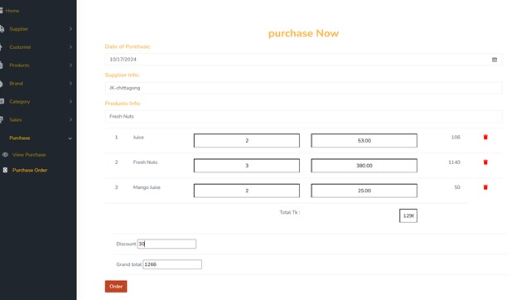
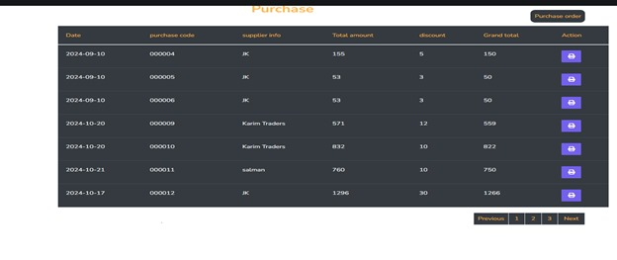
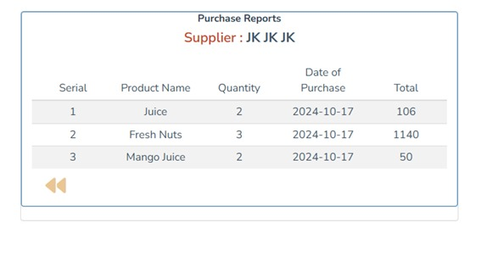
Purchase Order
View Purchase
Purchase Report

Slide 17
Limitations
No Mobile App Integration
Manual Sales Entry
Limited Scalability
Complex User Interface
No Online Purchase
17

Slide 18
Project Structure and Workflow
ANIKA CHAKRABORTY
(Product, Purchase, Sales, Purchase Report)
ORNI BANIK
Designing Part:(Home page, User Dashboard, Shop)
MOUMITA NAG
(Supplier, Customer, Category, Brand)
MIFTAHUL JANNAT
(User Registration, Login, Logout)

Slide 19


Slide 20


